Slide 1
Python Dictionaries
S1 MCA

Slide 2
Dictionary
Dictionaries are used to store data values in key:value pairs.
A dictionary is a collection which is ordered*, changeable and do not allow duplicates.
As of Python version 3.7, dictionaries are ordered. In Python 3.6 and earlier, dictionaries are unordered.
Dictionaries are written with curly brackets, and have keys and values
>>> thisdict = { "brand": "Ford", "model": "Mustang", "year": 1964 } print(thisdict)

Slide 3
Dictionary Items
Dictionary items are ordered, changeable, and do not allow duplicates.
Dictionary items are presented in key:value pairs, and can be referred to by using the key name.
>>> thisdict = { "brand": "Ford", "model": "Mustang", "year": 1964 } print(thisdict["brand"])

Slide 4
Changeable
Dictionaries are changeable, meaning that we can change, add or remove items after the dictionary has been created.
Duplicates Not Allowed
Dictionaries cannot have two items with the same key:
Duplicate values will overwrite existing values:
>>> thisdict = { "brand": "Ford", "model": "Mustang", "year": 1964, "year": 2020 } print(thisdict)

Slide 5
Dictionary Length
To determine how many items a dictionary has, use the len() function
>>> print(len(thisdict))
Dictionary Items - Data Types
The values in dictionary items can be of any data type:
>>> thisdict = { "brand": "Ford", "electric": False, "year": 1964, "colors": ["red", "white", "blue"] }
type()
From Python's perspective, dictionaries are defined as objects with the data type 'dict':
<class 'dict'>

Slide 6
The dict() Constructor
It is also possible to use the dict() constructor to make a dictionary.
>>> thisdict = dict(name = "John", age = 36, country = "Norway") print(thisdict)

Slide 7
Accessing Items
You can access the items of a dictionary by referring to its key name, inside square brackets:
>>> thisdict = { "brand": "Ford", "model": "Mustang", "year": 1964 } x = thisdict["model"]
There is also a method called get() that will give you the same result:
>>> x = thisdict.get("model")

Slide 8
Get Keys
The keys() method will return a list of all the keys in the dictionary.
>>> x = thisdict.keys()
The list of the keys is a view of the dictionary, meaning that any changes done to the dictionary will be reflected in the keys list.
>>> car = { "brand": "Ford", "model": "Mustang", "year": 1964 } x = car.keys() print(x) #before the change car["color"] = "white" print(x) #after the change

Slide 9
Get Values
The values() method will return a list of all the values in the dictionary.
>>> x = thisdict.values()
The list of the values is a view of the dictionary, meaning that any changes done to the dictionary will be reflected in the values list.
>>> car = { "brand": "Ford", "model": "Mustang", "year": 1964 } x = car.values() print(x) #before the change car["year"] = 2020 print(x) #after the change

Slide 10
Add a new item to the original dictionary, and see that the values list gets updated as well:
>>> car = { "brand": "Ford", "model": "Mustang", "year": 1964 } x = car.values() print(x) #before the change car["color"] = "red" print(x) #after the change

Slide 11
Get Items
The items() method will return each item in a dictionary, as tuples in a list.
Get a list of the key:value pairs
>>> thisdict = {
"brand": "Ford",
"model": "Mustang",
"year": 1964
}
x = thisdict.items()
print(x)

Slide 12
Add a new item to the original dictionary, and see that the items list gets updated as well
>>> car = { "brand": "Ford", "model": "Mustang", "year": 1964 } x = car.items() print(x) #before the change car["color"] = "red" print(x) #after the change

Slide 13
Check if Key Exists
To determine if a specified key is present in a dictionary use the in keyword:
>>> thisdict = { "brand": "Ford", "model": "Mustang", "year": 1964 } if "model" in thisdict: print("Yes, 'model' is one of the keys in the thisdict dictionary")
→ Check if "model" is present in the dictionary

Slide 14
Change Values
You can change the value of a specific item by referring to its key name
>>> thisdict = { "brand": "Ford", "model": "Mustang", "year": 1964 } thisdict["year"] = 2018

Slide 15
Update Dictionary
The update() method will update the dictionary with the items from the given argument.
The argument must be a dictionary, or an iterable object with key:value pairs.
>>> thisdict = { "brand": "Ford", "model": "Mustang", "year": 1964 } thisdict.update({"year": 2020})

Slide 16
Adding Items
Adding an item to the dictionary is done by using a new index key and assigning a value to it:
>>> thisdict = { "brand": "Ford", "model": "Mustang", "year": 1964 } thisdict["color"] = "red" print(thisdict)

Slide 17
Update Dictionary
The update() method will update the dictionary with the items from a given argument. If the item does not exist, the item will be added.
The argument must be a dictionary, or an iterable object with key:value pairs.
>>> thisdict = { "brand": "Ford", "model": "Mustang", "year": 1964 } thisdict.update({"color": "red"})

Slide 18
Removing Items
There are several methods to remove items from a dictionary:
The pop() method removes the item with the specified key name:
>>> thisdict = { "brand": "Ford", "model": "Mustang", "year": 1964 } thisdict.pop("model") print(thisdict)

Slide 19
The popitem() method removes the last inserted item (in versions before 3.7, a random item is removed instead)
>>> thisdict = { "brand": "Ford", "model": "Mustang", "year": 1964 } thisdict.popitem() print(thisdict)
The del keyword removes the item with the specified key name
>>> thisdict = { "brand": "Ford", "model": "Mustang", "year": 1964 } del thisdict["model"] print(thisdict)

Slide 20
The del keyword removes the item with the specified key name
>>> thisdict = { "brand": "Ford", "model": "Mustang", "year": 1964 } del thisdict print(thisdict) #this will cause an error because "thisdict" no longer exists.
The clear() method empties the dictionary
>>> thisdict = { "brand": "Ford", "model": "Mustang", "year": 1964 } thisdict.clear() print(thisdict)

Slide 21
Loop Through a Dictionary
You can loop through a dictionary by using a for loop.
When looping through a dictionary, the return value are the keys of the dictionary, but there are methods to return the values as well.
Print all key names in the dictionary, one by one
>>> thisdict = {
"brand": "Ford",
"model": "Mustang",
"year": 1964
}
for x in thisdict:
print(x)

Slide 22
Print all values in the dictionary, one by one:
>>> thisdict = {
"brand": "Ford",
"model": "Mustang",
"year": 1964
}
for x in thisdict:
print(thisdict[x])
You can also use the values() method to return values of a dictionary
>>> for x in thisdict.values(): print(x)

Slide 23
You can use the keys() method to return the keys of a dictionary
>>> for x in thisdict.keys(): print(x)
Loop through both keys and values, by using the items() method
>>> for x, y in thisdict.items(): print(x, y)

Slide 24
Copy a Dictionary
You cannot copy a dictionary simply by typing dict2 = dict1,
because: dict2 will only be a reference to dict1, and changes made in dict1 will automatically also be made in dict2.
There are ways to make a copy, one way is to use the built-in Dictionary method copy().
>>> thisdict = { "brand": "Ford", "model": "Mustang", "year": 1964 } mydict = thisdict.copy() print(mydict)

Slide 25
Another way to make a copy is to use the built-in function dict().
>>> thisdict = { "brand": "Ford", "model": "Mustang", "year": 1964 } mydict = dict(thisdict) print(mydict)

Slide 26
Nested Dictionaries
A dictionary can contain dictionaries, this is called nested dictionaries.
>>> myfamily = { "child1" : { "name" : "Emil", "year" : 2004 }, "child2" : { "name" : "Tobias", "year" : 2007 }, "child3" : { "name" : "Linus", "year" : 2011 } }

Slide 27
Create three dictionaries, then create one dictionary that will contain the other three dictionaries:
>>> child1 = { "name" : "Emil", "year" : 2004 } child2 = { "name" : "Tobias", "year" : 2007 } child3 = { "name" : "Linus", "year" : 2011 } myfamily = { "child1" : child1, "child2" : child2, "child3" : child3 }

Slide 28
Access Items in Nested Dictionaries
To access items from a nested dictionary, you use the name of the dictionaries, starting with the outer dictionary:
>>> print(myfamily["child2"]["name"])

Slide 29
Loop Through Nested Dictionaries
You can loop through a dictionary by using the items() method like this
>>> for x, obj in myfamily.items(): print(x) for y in obj: print(y + ':', obj[y])

Slide 30
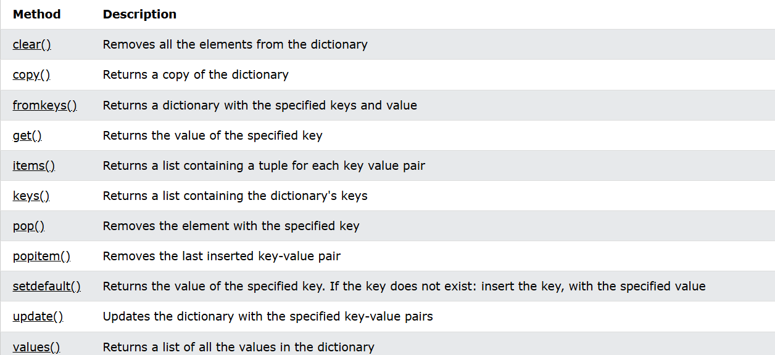
Dictionary Methods

